Slide 1
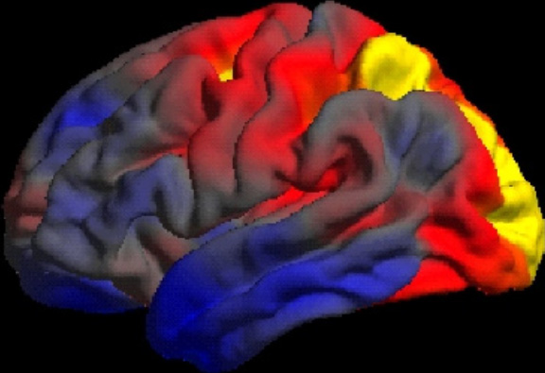
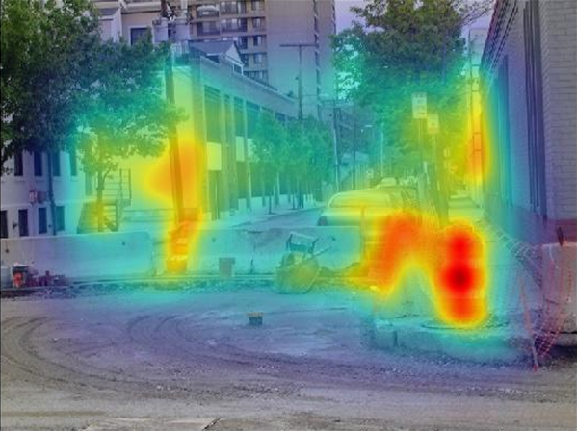
Understanding and supporting people with dementia-related visual impairment
Please use the accompanying notes in the workbook
when completing this Group CPD session
Photos courtesy of: Lehmann et al. (2011); Shakespeare et al. (2015)

Slide 2
Learning outcomes
Consolidate knowledge of the core features of several dementias
Develop greater depth of understanding that dementia-related visual impairment may be a symptom of different forms of dementia, arising from damage to the brain rather than the eye
Critically consider the lived experience of dementia-related visual impairment and its impact on occupational performance
Debate and reflect upon the occupation based contributions that occupational therapists can make, to assist people with visual processing problems resulting from dementia
Debate and discuss the ways that occupational therapists can work collaboratively, across organisational boundaries, to support people with dementia-related visual impairment and their families to live their lives their way

Slide 3
Share your key learning points about what you have learnt about the dementias and the associated visual impairments (10mins)

Slide 4
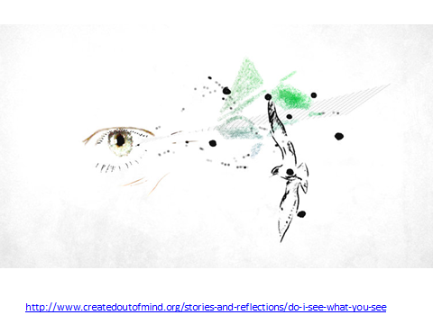
Share your key learning points about what it is like to live with dementia and the associated visual impairments (10mins) – what have you learnt?
Animation by: Simon Ball, supported by the Alzheimer’s Society and the Wellcome Trust

Slide 5
As occupational therapists, what can we do to support people who live with dementia-related visual impairments and their families (25mins)
Occupation-centred
describes an approach where occupation is at the core. It is made up of occupation-focused and occupation-based practice
Pragmatic reasoning and evidence base
Solution focused
Occupation-focused
describes practice where information about the person, environment and occupation relates closely with occupational performance
Occupation-based
describes practice where the ‘doing’ of occupation is the main ingredient in assessment, intervention and measure of outcomes

Slide 6
Integrated services – what does this mean to you? (5 mins)
What is available locally?
Make inter-professional links across traditional boundaries
Role of the charitable and voluntary sector
Research trials – opportunity for participation

Slide 7
Understanding and supporting people with dementia-related visual impairment
References, further reading and resources are listed in the back of your CPD workbook
Please capture your immediate take home points and your future learning needs in your workbook

Slide 8
Further information
For further information on the Seeing What They See research team
http://www.ucl.ac.uk/dementia-vision

