Slide 1
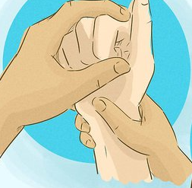
Assessment and management of the rheumatoid hand
Catherine McCoy
Northern Care Alliance (Salford Care Organisation)
Occupational Therapy Advanced Practitioner
Catherine.mccoy@nca.nhs.uk
Twitter: @CathMcCoy @RCOT_TMH

Slide 2

Learning objectives
To provide a refresher on:
  Relevant hand anatomy and biomechanics
  The effects of rheumatoid disease on the hand
To increase understanding of the deformities seen in the rheumatoid hand
To develop knowledge of therapeutic management options and the underpinning evidence for these
To discuss considerations for surgery in the rheumatoid hand
To share the expertise of the group
Member questions and opportunities for group discussions

Slide 3
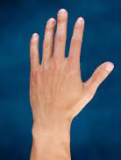
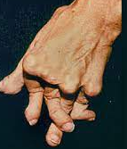
Challenges for hand therapy in rheumatology
Lack of robust research evidence – clinical reasoning needs to be guided by knowledge of anatomy and biomechanics
Limitations of applying available research evidence to clinical caseload – progression of DMARD therapies, clinic capacity etc.
Clinical pressures and resources
Opportunities for therapists new to rheumatology to develop skill and confidence in assessing and treating rheumatoid deformities

Slide 4
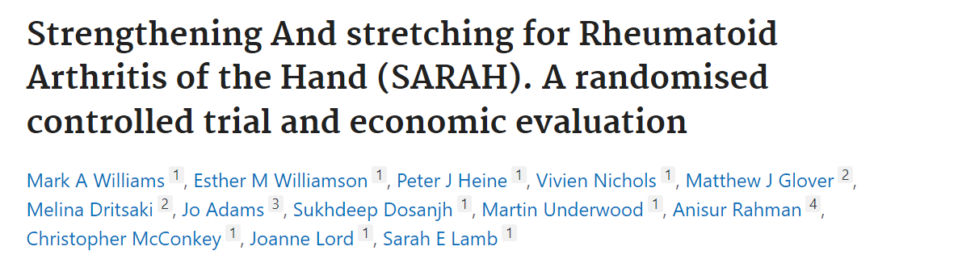
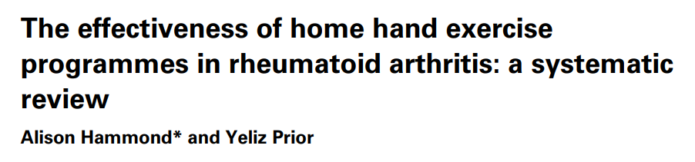
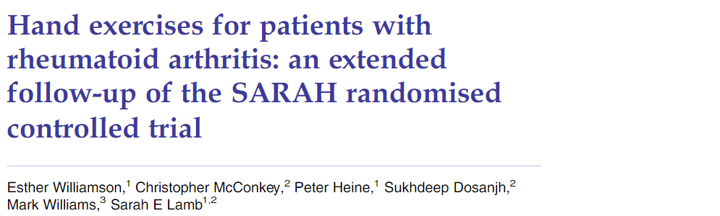
Evidence for exercise programmes in rheumatology
Investigator blinded multi-centre RCT (2015)
6 therapy supervised sessions, 7 mobility + 4 resistance exercises
Strategies to facilitate adherence
Demonstrated SARAH programme to be cost and clinically effective in improving hand function, with change maintained over a 12 month period
Systematic literature review (2016)
HEPs improve hand function, grip and pain
Benefits less consistent in longer term (6-12 months), in particular with respect to ROM – strategies needed to facilitate long term adherence
Most effective programmes - high intensity therapy supervised (4+ sessions) and include resistance exercises
Recommended 4-6 light progressing to medium resistance exercises performed at high intensity
? efficacy for one session +/- FU high intensity programme – lack of evidence
SARAH participants had improved hand function compared with baseline >2 years post randomisation (not statistically significant in control group)
Overall the score differences between treatment and control groups no longer statistically significant
Effect of programme and adherence diminished over time

Slide 5
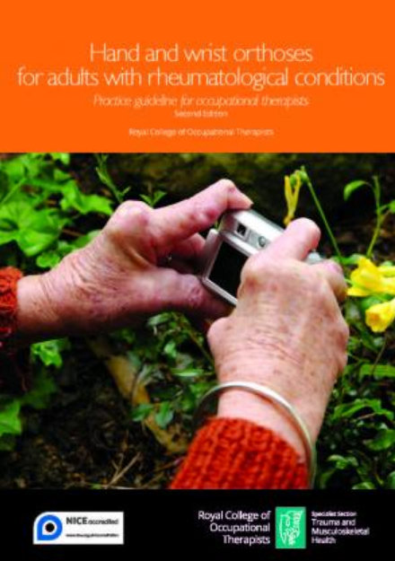
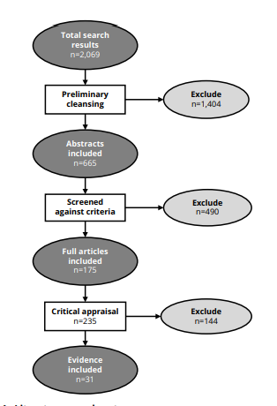
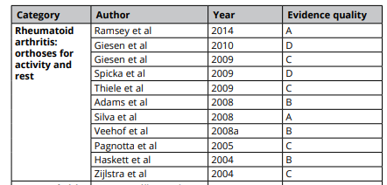
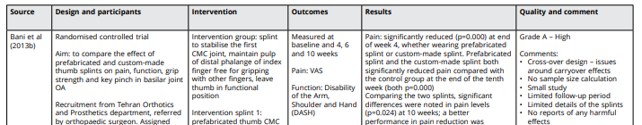
Evidence for splinting in rheumatology
Evidence based recommendations for OTs working with adults who may benefit from hand or wrist orthosis as an intervention for a rheumatological condition.
Includes practice guidelines, CPD session, quick reference & implementation guide and hand and wrist audit tool.

Slide 6
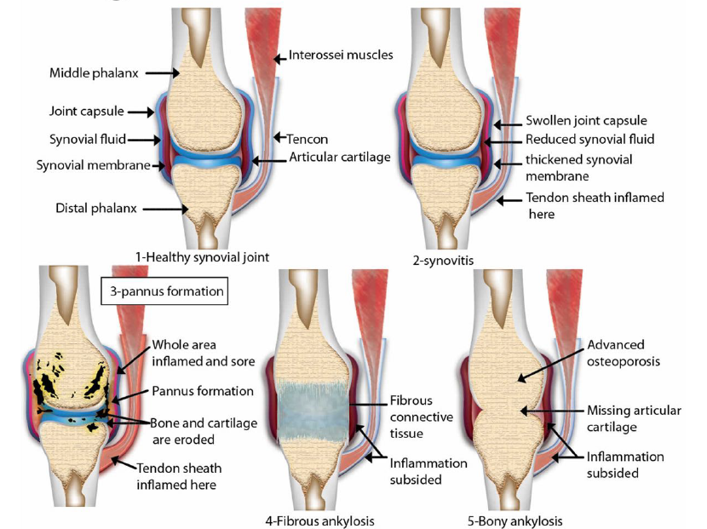
The effect of RA on the hand joints and surrounding soft tissues
- Synovitis
- Pannus formation
- Fibrous ankylosis
- Bony ankylosis

Slide 7
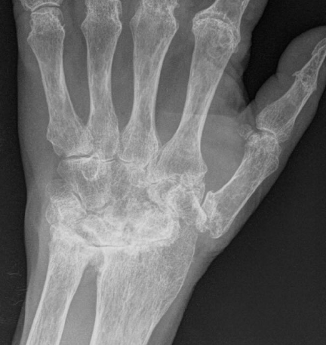
The wrist in rheumatoid disease
Synovitis DRUJ and RCJ → Laxity - DRUJ, SL ligament, UCL
Caput Ulnae syndrome – stretching of ulnar carpal ligaments secondary to synovitis → dorsal dislocation of distal ulna, supination of carpus on hand, volar subluxation of ECU → ulnar translocation and radial deviation of wrist
Complications –
  Pain and mechanical blocking of forearm rotation and restricted wrist ROM
  Potential for rupture of extensor tendons (Vaughn-Jackson syndrome)
  MCPJ ulnar deviation secondary to wrist radial deviation

Slide 8
Exercises for the wrist in rheumatoid disease
SARAH trial (Lamb et al 2014)
  Wrist circumduction
  ? provocative if inflamed/unstable ECU
  Eccentric (+concentric) wrist extension with forearm in mid-prone
Avoid passive stretches in active disease
  Stretching of joint capsule → increased risk of ligamentous laxity
Discussion points…
What is the optimum position for the forearm when working on wrist extension? (activation of ECU)
Is there a role for early isometric strengthening in a stable position before stable on DMARD therapy?

Slide 9
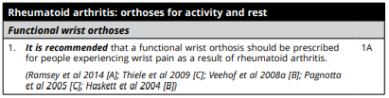
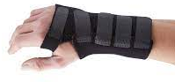
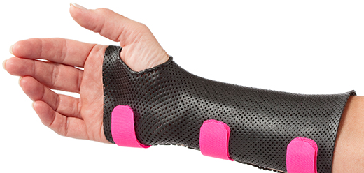
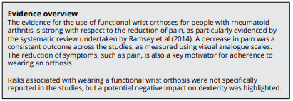
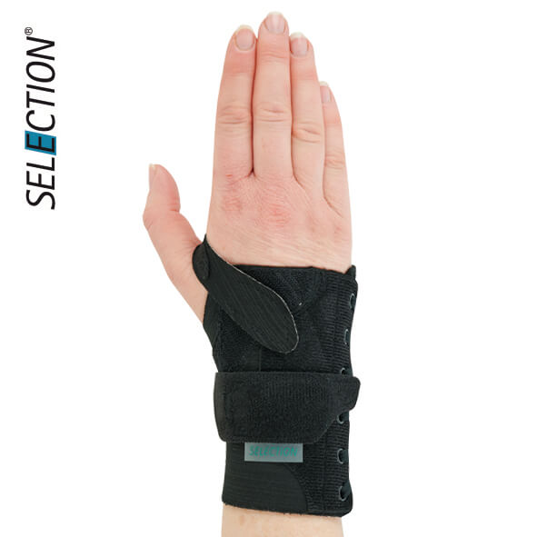
Splinting the wrist in rheumatoid disease
RCOT 2022

Slide 10
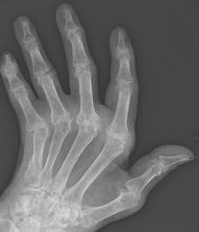
The MCP joints
Volar subluxation at the base of the proximal phalanx with UD of digits
UD – asymmetry of MC heads, joint synovitis, predisposition of tendons to ulnar pull, muscle imbalance
Ring and little fingers – increased CMCJ mobility
Weakening of transverse fibres of extensor hood → ulnar subluxation of extensors
RCL rupture
Weakness of extensors due to volar displacement - unopposed flexor activity, intrinsic muscle tightness

Slide 11
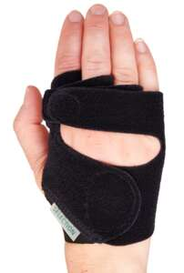
Splinting and exercise for the MCP joints
Consider wrist position and inclusion
  Ulnar drift may be secondary to wrist radial deviation
MUD splints
  No good quality research evidence to support use
  Rennie (1996) – improved anatomical alignment and 3-point pinch
  No statistically significant in hand function, pain, gross grip or lateral pinch
  Can be bulky and difficult to wear
  ? Potential benefits of altered biomechanics from improved joint alignment
Night splinting ? support in maintaining passive range, wrist alignment if passively correctable
Exercise
  Strengthening of radial intrinsics (radial finger walking) – SARAH trial
  Isolated MCPJ flexion (knuckle bends) – SARAH trial
Joint protection – education, activity modification and assistive devices to prevent ulnar forces at MCPJs
Discussion point…
Does anybody teach active finger (hyper) extension from table top ?
What would the rationale be for this as an exercise in RA?
Notes:
? Active finger (hyper) extension from table top

Slide 12
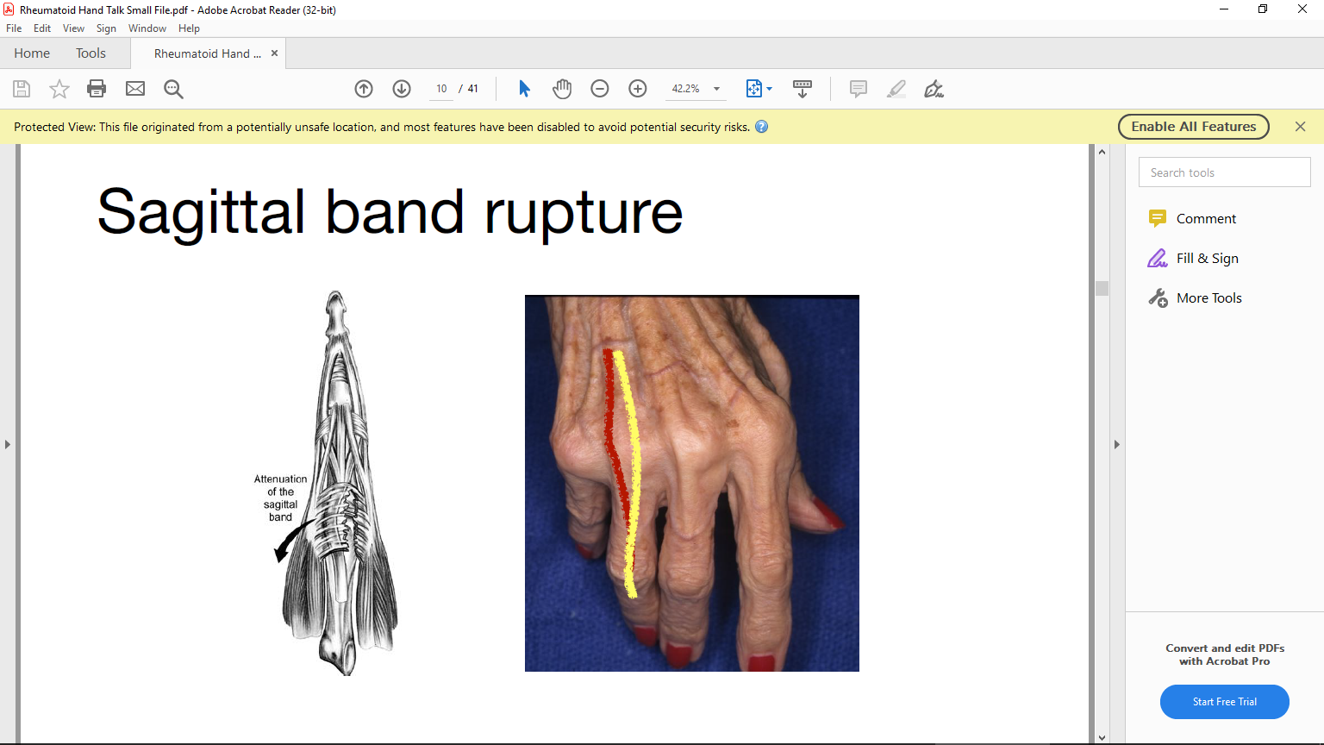
Sagittal band rupture
Primary stabiliser of extensor tendon at MCPJ
Can rupture in inflammatory disease → tendon snapping as extensor subluxes and relocates or loss of ability to initiate MCPJ extension
Pseudo-triggering!
MCPJ position can be maintained after passive extension
Most unstable during MCPJ flexion with wrist flexed, more stable when wrist extended
Clinical examination - observation of extensor during MCPJ flexion (can be observed subluxing into intermetacarpal space)
USS – if needed to confirm clinical diagnosis

Slide 13
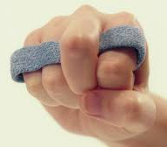
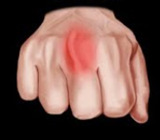
Management of sagittal band rupture in the rheumatoid hand
Passive stretches and night extension splint to maintain range
Yoke splint (pre/post surgery)
Sagittal band reconstruction

Slide 14
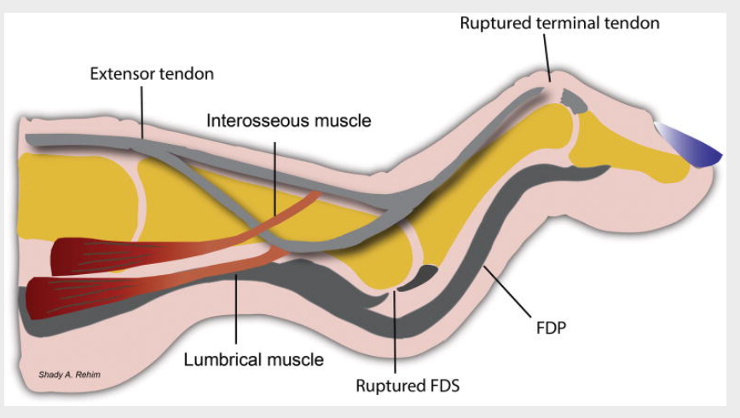
Swan neck deformity
Multiple possible causes:
  Attenuation of PIPJ volar plate, collateral ligaments and/or rupture of FDS insertion - PIPJ hyperextends due to unopposed extensor force.
  Secondary to deformities of MCPJ or DIPJ
    MCPJ volar subluxation or flexion secondary to intrinsic muscle tightness → compensatory hyperextension PIPJ
    Dorsal displacement and intrinsic tightness of lateral bands → further extension PIPJ
    Disruption of EDC insertion at DIPJ → proximal shift of extensor force onto PIPJ
Rehim and Chung (2013)

Slide 15

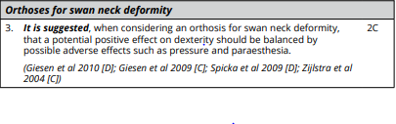

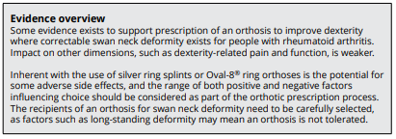
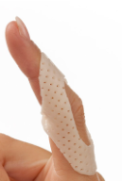

Splinting for swan neck deformity

Slide 16
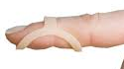
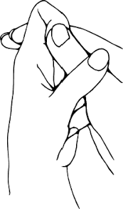
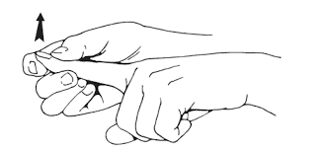
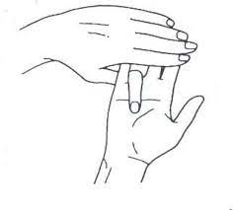
Exercise for swan neck deformity
Discussion points…
If secondary to inflammatory pathology at MCPJ is there a role for splinting MCPJ in improved extension/limit flexion?
Is there a role for corrective splinting of DIPJ / oval-8 splinting at PIPJ as preventative measure in mallet deformity?
Active and passive exercises to maintain / regain range and prevent fixed deformity
Isolated FDS to encourage activation

Slide 17
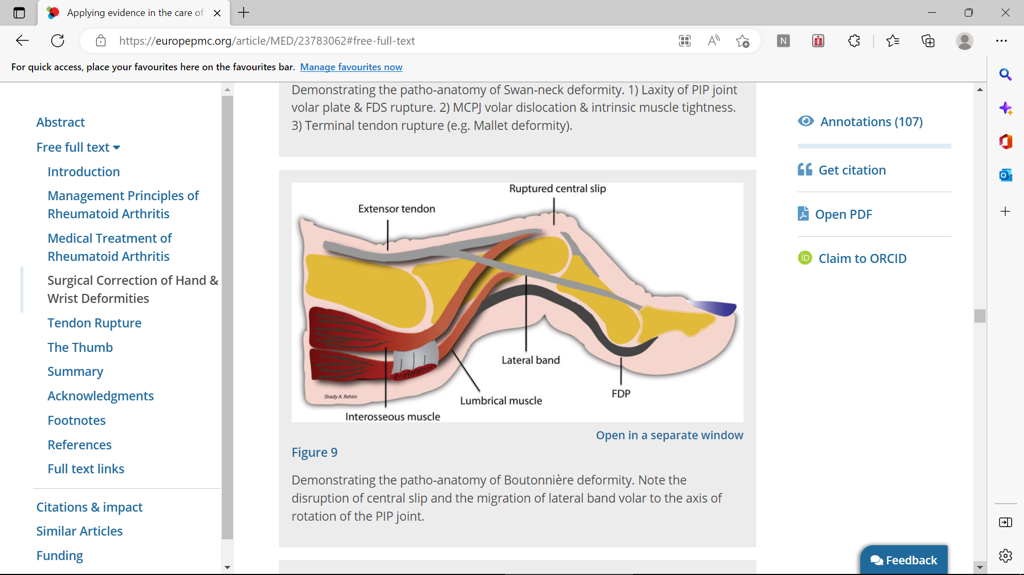
Boutonniere deformity
Central slip disruption
Attenuation of extensor mechanism and triangular ligament → volar subluxation of lateral bands → act as flexors instead of extensors at PIPJ
Increased tension of lateral bands distally and tightness of ORL → Loss of DIPJ flexion progressing to hyperextension
Articular cartilage destruction + altered joint biomechanics = joint contracture
Rehim and Chung (2013)

Slide 18

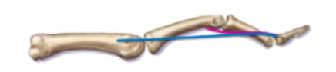
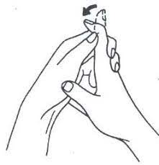
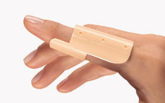
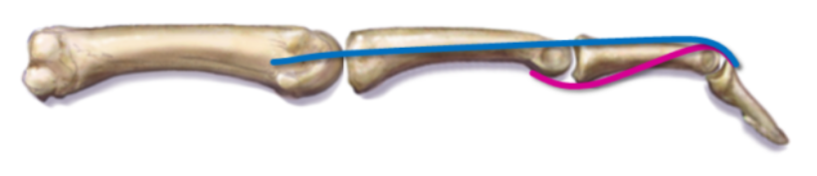
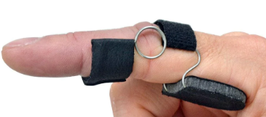
Boutonniere deformity
Member question
What would be the rationale, benefits and risks of immobilising the PIPJ in extension in early Boutonniere deformity?
Splinting
  ? Capner (armchair) splint
  Night splinting
  ? application of acute boutonniere guidelines to deformity secondary to inflammatory pathology
Exercise
  Passive stretches - PIPJ extension and DIPJ flexion
  If full PIPJ extension can be achieved passively - ORL stretches

Slide 19
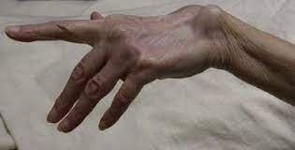
Extensor tendon rupture
Loss of active extension of fingers – usually sequential starting at ulnar digits (Vaughn-Jackson)
Passive range maintained but may become stiff over time +/- be limited by MCPJ subluxation
Inflammatory causes – attrition rupture, persistent synovitis/tenosynovitis
  Progressive subluxation and dorsal displacement of ulnar head → mechanical stress on extensor tendons
Differential diagnosis:
  PIN palsy
  Sagittal band rupture
  MCP subluxation/dislocation
  Trigger finger

Slide 20
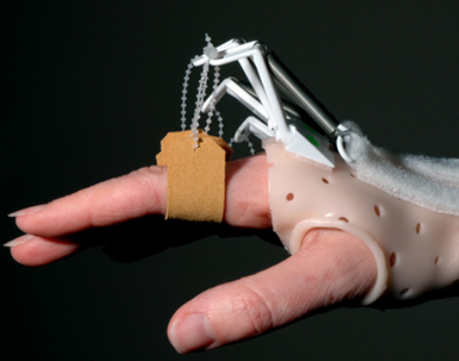
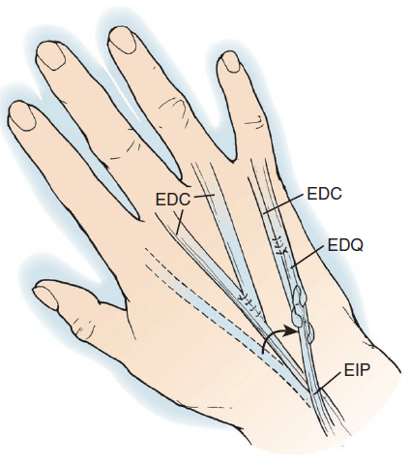
Management of extensor rupture in the rheumatoid hand
Passive stretches and night splinting to maintain range
Functional splinting while awaiting surgery or if not wanting/suitable for surgical management – outrigger (neoprene if outrigger not tolerated)
Extensor tendon transfers
Post operative splinting and hand therapy

Slide 21
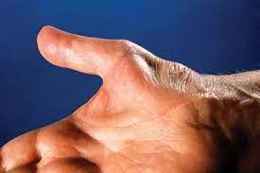
Hand Paraesthesia
Peripheral nerve entrapment
  Sensory and motor supply
  Clinical tests
  ? Secondary to inflammatory pathology
Differential diagnosis – cervical spine, red flag questions, other pathology (peripheral neuropathy, thyroid etc.)
Splinting -
  Carpal tunnel - wrist neutral
  Cubital tunnel – elbow extension ( <30⁰)
  ? Night only
Notes:
Orthohub

Slide 22
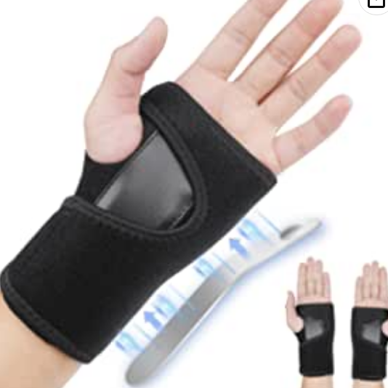
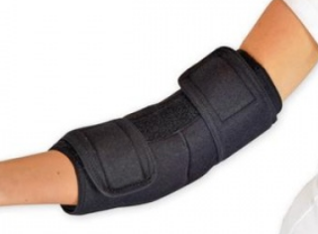
Exercise and splinting for peripheral nerve entrapment
Splinting –
  Carpal tunnel - wrist neutral
  Cubital tunnel – elbow extension ( <30⁰)
  ? Wearing regime and duration
Exercise –
  Nerve glides
Activity modification –
  Wrist/elbow position
  Internal/external pressure
  Aggravating factors
Notes:
Orthohub

Slide 23
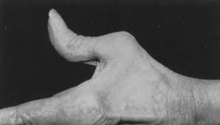
The rheumatoid thumb
Range of deformities can occur
Vary in primary and secondary causes, involvement of and effect on the CMC, MCP and IP joints of the thumb
Z-deformity (most commonly associated with RA)
Synovitis at MCPJ
→ stretching of EPB and EPL, weakening of the joint capsule
→ volar subluxation of proximal phalanx with loss of active MCPJ extension
→ compensatory radial abduction of 1st MC and hyperextension of IPJ
Hyperextension of IPJ and flexion of MCPJ accentuated when pinch forces applied
In some cases IPJ hyperextension can be primary and MCPJ flexion secondary

Slide 24
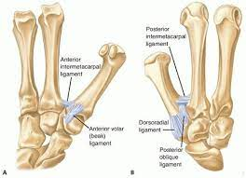
CMCJ subluxation in the thumb
Degenerative changes at thumb CMCJ
Volar oblique (beak) ligament laxity and attenuation
Volar subluxation of thumb metacarpal on trapezium
Pain secondary to this leads to altered biomechanics - ↑ use of adductor pollicis in lateral pinch → increased loading at thumb CMCJ → further subluxation

Slide 25
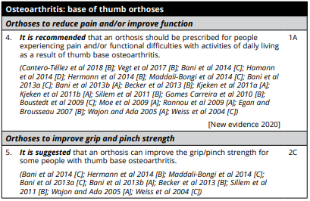
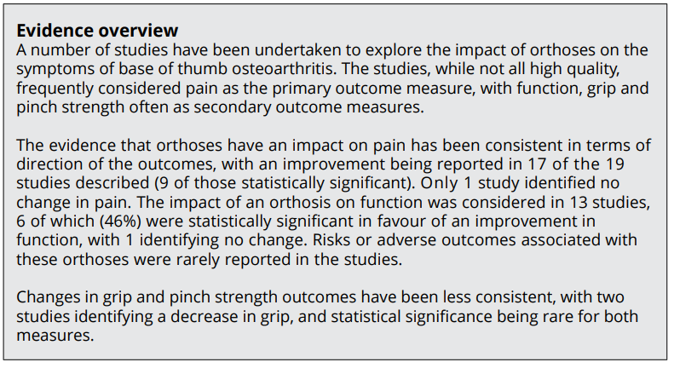
Splinting thumb osteoarthritis
Range of splint options - consider goals of splinting and which joints to include

Slide 26

Therapy management of thumb arthritis
Determine position of deformity and altered biomechanical forces
Joint protection:
  Encourage abduction and tip-to-tip pinch to offload forces at CMCJ (MCPJ hyperextension during lateral pinch encourages reciprocal flexion of MC shaft dorsal subluxation and it’s base)
Exercise:
  Strengthening of EPB, APB, and OP with resisted pinch grip exercises in stable position (Scott 2018; DeMott 2017)
  Gentle passive stretches and strengthening the abductors and wrist extensors may help maintain the first web space, avoid adduction deformity and improve thumb stability (Valdes et al 2012)
  APL in early OA to maintain webspace, avoid APL strengthening with more advanced arthritic changes (insertion at base of 1st MC can exacerbate dorsal subluxation)
  Modify/stop if any collapse of CMCJ into adduction/flexion

Slide 27
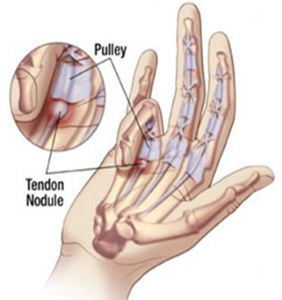
Trigger finger in the rheumatoid hand
Inhibition of smooth flexor tendon gliding caused my mechanical impingement of the flexor tendon (most commonly) at the first annular (A1) pulley
Research++ looking at histopathology in primary trigger finger
Not always inflammatory but common in RA secondary to flexor tenosynovitis
Usually presents with progressive pain, clicking, catching and locking of finger/thumb
Grades available to describe the stage of trigger finger (Green classification)
Usually a firm flexor nodule can be felt in the palm, often tender to palpation
Treatment options – splint, steroid injection, surgical release of A1 pulley

Slide 28
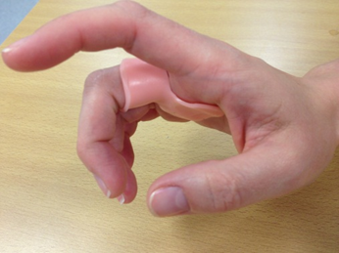
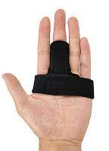
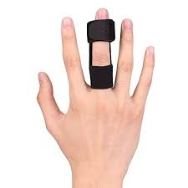
Exercise and splinting for trigger finger
Splinting
  Limit flexor tendon excursion
  Trigger finger ring splint – prevent MCPJ flexion >30⁰ while allowing functional use of hand
  Night splinting – rest / serial splint PIPJ contracture
Exercise
  Maintain active and passive ROM – especially if daytime splinting
  Avoid repetitive/forceful gripping
Discussion points…
What types of splint are you using for trigger finger?
Which joints do you immobilise…and does it matter?
What wearing regime do you advise?

Slide 29



Resting splints for RA
Member question
When is it appropriate to provide a hand resting splint for inflammatory arthritis?
Deformity
Flare
? Role of Isotonors – hand posture support

Slide 30
Hand function assessment
Member question
How is hand function being assessed in clinical practice?
What standardised and non standardised assessments are being used?

Slide 31

Considerations for surgery
Goals
Reduce pain
Improve function
Prevent further loss of function
Improve cosmesis
Timing
  Disease stability
  Refractory disease
  DMARD therapies
  Staging of procedures

Slide 32



Surgical management options for the rheumatoid wrist and hand
Wrist | Synovectomy / tenosynovectomy Distal ulna resection - Darrach’s / Suave-Kapandji Arthrodesis - partial/total Arthroplasty - chronic DRUJ instability/failed distal ulna resection/pancarpal disease
MCPJs | Synovectomy Intrinsic release Cross intrinsic transfer Extensor tendon centralisation MCP arthroplasty (plus soft tissue reconstruction) Sagittal band reconstruction
IPJs | Arthodesis Arthroplasty Soft tissue reconstruction – FDS tenodesis, retinacular ligament reconstruction, central slip reconstruction
Thumb | Trapeziectomy Arthodesis Arthroplasty
Tendons | Tendon transfer procedures
Rehim and Chung (2013)

Slide 33
Questions?

Slide 34
References
Adams et al. (2008) The clinical effectiveness of static resting splint in early RA: a RCT
Hammond et al (2021) Clinical and cost effectiveness of arthritis gloves in Rheumatoid Arthritis (A-GLOVES): randomised controlled trial with economic analysis
Bergstra et al. (2014) A systematic review into the effectiveness of hand exercise therapy in the treatment of RA
Lamb et al. (2014) Exercises to improve function of the rheumatoid hand (SARAH): a randomised controlled trial
Callinan & Mathiowetz (1996) Soft versus hard resting hand splints in RA: pain relief, preference and compliance
Hammond et al. (2021) – The effects of arthritis gloves on people with RA or Inflammatory Arthritis with hand pain (A-Gloves trial)
Hammond and Prior (2016) The effectiveness of home hand exercise programmes in RA: a systematic review
Ramsay et al (2014) The effectiveness of working wrist splints in adults with RA: a mixed methods systematic review
Royal College of Occupational Therapists (2020) Hand and wrist orthoses for adults with rheumatological conditions: Practice guideline for Occupational Therapists
Silva et al. (2008) Effectiveness of a night-time hand positioning splint in RA: a RCT
Veehof et al. (2008 Determinants of the use of wrist working splints in RA
Scott A. Is a Joint-specific home exercise programme effective for patients with first carpometacarpal joint osteoarthritis? A critical review. Hand Therapy. 2018;23(3):83-94.
DeMott L. Novel isometric exercises for the dynamic stability programs for thumb carpal metacarpal joint instability. Journal of Hand Therapy. 2017 Jul-Sep;30(3):372-375.
Valdes K, Von Der Hyde R. An Exercise Program for Carpometacarpal osteoarthritis based on biomechanical principles. Journal of Hand Therapy. 2012 25(3): 251-262

